Slide 1
ETL Project
Diversity – Household income – Unemployment relationship
Pragathi Madushinie

Slide 2
Summary :
Project title: ETL Project Income Unemployment Diversity
Name of implementing person(s): Pragathi M Porawakara Arachchige
Project location: Data Analytics Boot Camp – WashU
Proposed starting date: 07/09/2019
Project duration: 1 week

Slide 3
ETL Project has three sections:
I. Extracting data from different data sources
II. Transform the data to a presentable format
III. Load them to a database either relational or non-relational

Slide 4
Summary of the ETL Project : E – Extraction T – Transformation L - Load
Extraction from multiple data sets which has a csv files.
Use pandas for the Transformation process. Data Cleanup & Analysis was also done through pandas. Merged all the three data sets via pandas as well.
Finally loaded the transformed data frame in to PostgreSQL table, after creating it in Postgre SQL.

Slide 5
I. EXTRACTING DATA FROM DIFFERENT DATA SOURCES
I used 2 data sources and 3 datasets in my project.
Two data sources are Kaggle and Data World.
Kaggle -: https://www.kaggle.com
Data World -: https://data.world
Three data sets are Kaggle and Data World.
Kaggle -:
1. Diversity Index of US counties
https://www.kaggle.com/mikejohnsonjr/us-counties-diversity-index
2. US Unemployment Rate by County, 1990-2016
https://www.kaggle.com/jayrav13/unemployment-by-county-us
Data World -:
3. 2015 Median Income by County
https://data.world/tylerudite/2015-median-income-by-county

Slide 6
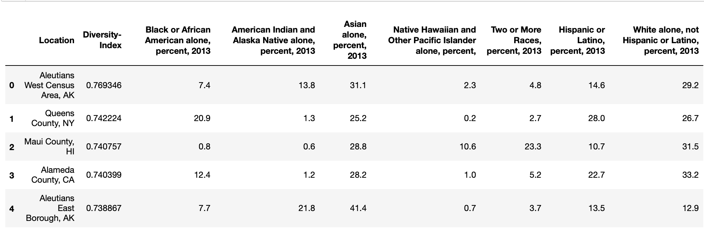
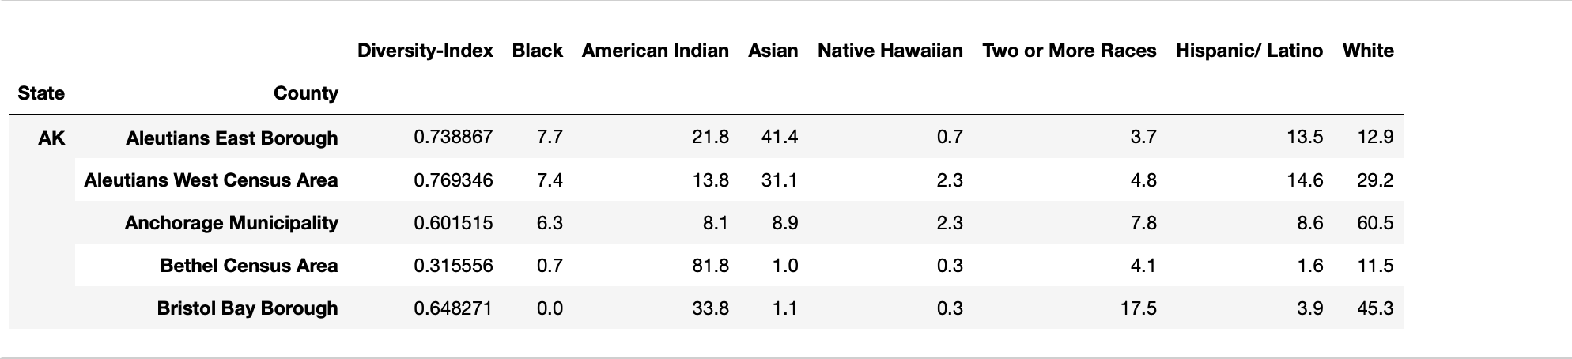
II. TRANSFORM DATA IN TO A PRESENTABLE FORMAT a. Diversity Data set
Diversity Extract Data Set
Diversity Transformed Data Set

Slide 7
1. As the location column contains both state and county, split in to two columns and named them State and County
2. Make it easier to merge and group with the other 2 datasets.
3. Renamed the column names to make them more readable.
4. At the same time grouping it by the columns.
5. Checking the data types of the columns
6. Converting object type columns to String

Slide 8
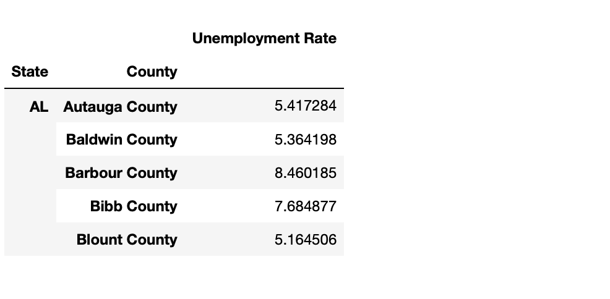
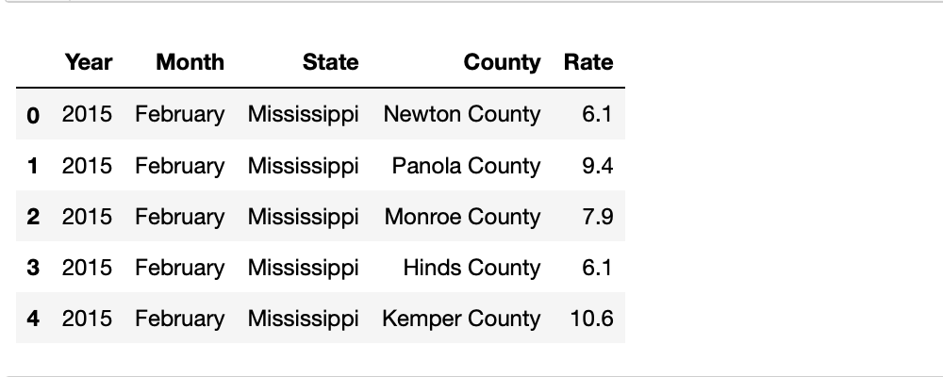
II. TRANSFORM DATA IN TO A PRESENTABLE FORMAT B. Unemployment Rate Data set
Unemployment Rate Extract Data Set
Unemployment Rate Transformed Data Set

Slide 9
1. State column was in full name, so needed to abbreviate them to merge with the rest of the data sets.
2. Make it easier to merge and group with the other 2 datasets.
3. A dictionary of states and their abbreviations were used with a loc loop to iterate through the dataset
4. Finally, grouped this dataset by State and County and averaged for each County.
5. Rename the column names
6. Extracted only the relevant columns from the data set
7. Checking the data types of the columns
8. Converting object type columns to String

Slide 10
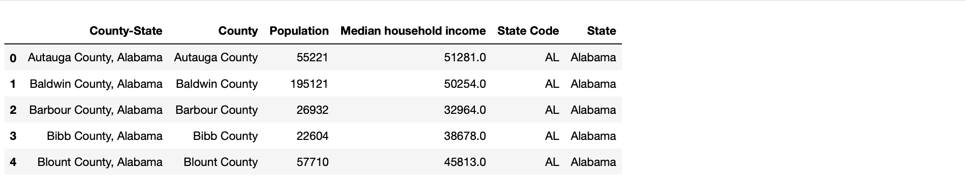
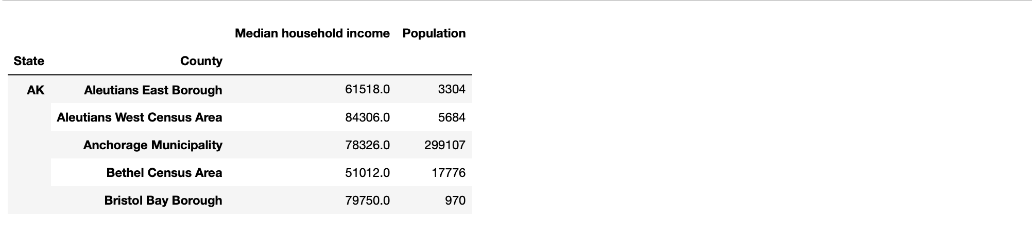
II. TRANSFORM DATA IN TO A PRESENTABLE FORMAT C. Median Population Income Data set
Median Population Income Extract Data Set
Median Population Income Transformed Data Set

Slide 11
1. Drop the columns County-State & State Those are duplicate columns.
Renamed the State Code column to State.
3. Make it easier to merge and group with the other 2 datasets.
4. Finally, grouped this dataset by State and County and averaged for each County.
6. Extracted only the relevant columns from the data set
7. Checking the data types of the columns
8. Converting object type columns to String

Slide 12
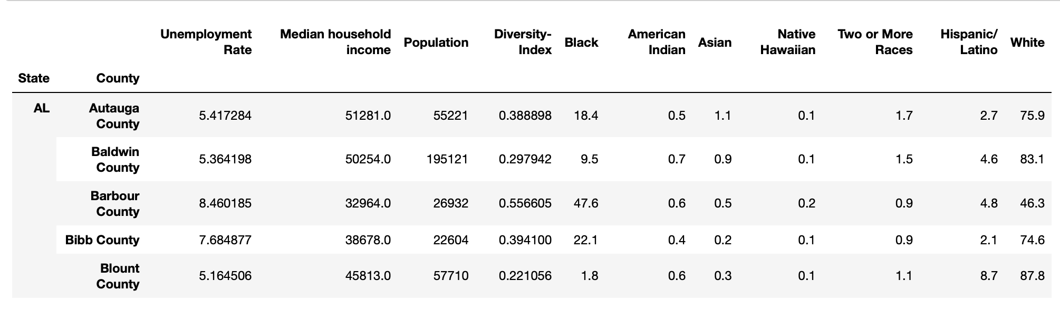
II. TRANSFORM DATA IN TO A PRESENTABLE FORMAT Merge the 3 data sets cleaned above
At this step, my data sets are cleaned up and ready to merge. I have decided my primary keys and what type of joins I am using to merge these 3 data sets.
To start, the Unemployment dataset and Median Income dataset were merged on State and County, using an inner join.
The Diversity dataset was then merged on that by State and County again, using an inner join as well.

Slide 13
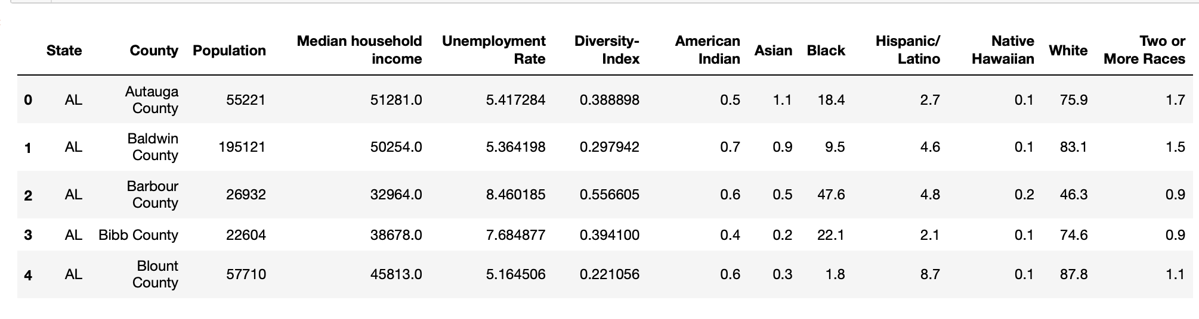
III. LOAD THE DATA SET IN TO A DATABASE
Last step was to transfer the final output which was transformed into a Database in Postgres SQL.
I created the database and respective tables to match the columns from the final Panda’s Data Frame using Postgres SQL .
And then connected to the database and loaded the result.

Slide 14
IV. My research questions
These were the questions I selected to get answers to from this process
• Most or Least Population.
• Median Household Income
• Unemployment Rate
• Diversity Index
• Race Index

Slide 15
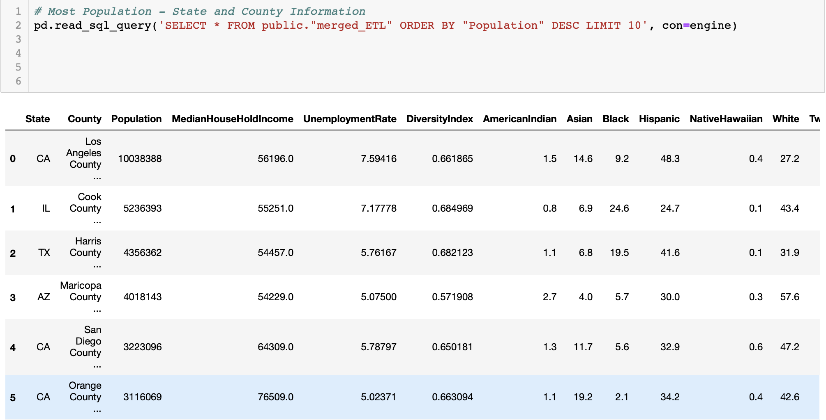
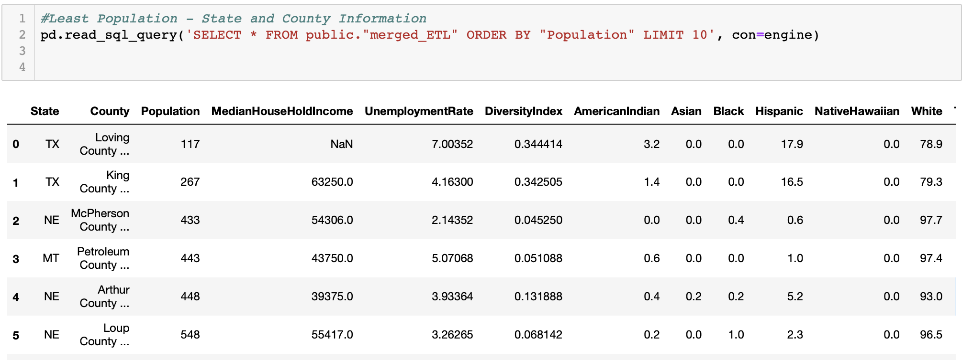
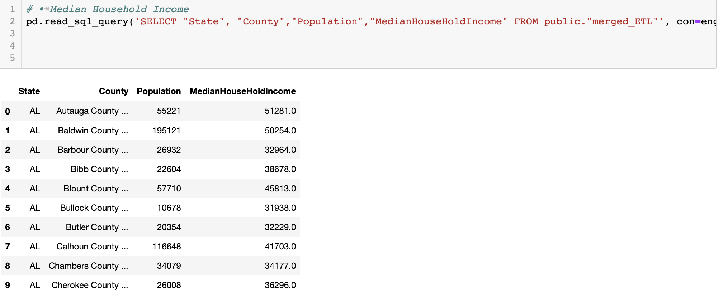
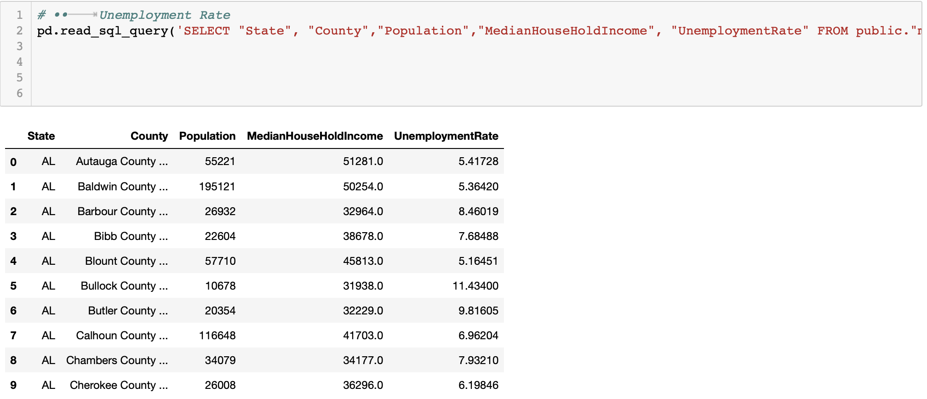
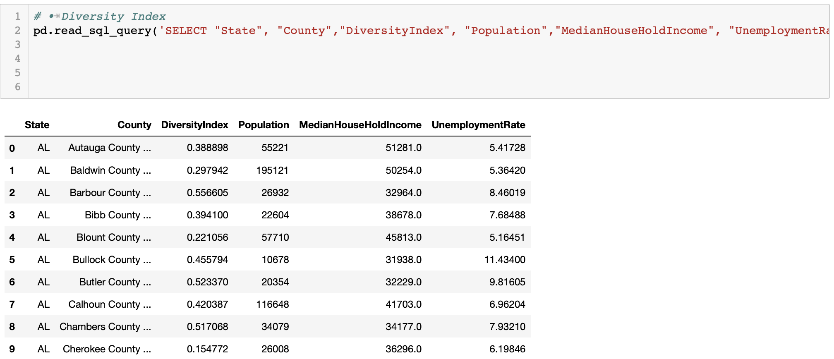
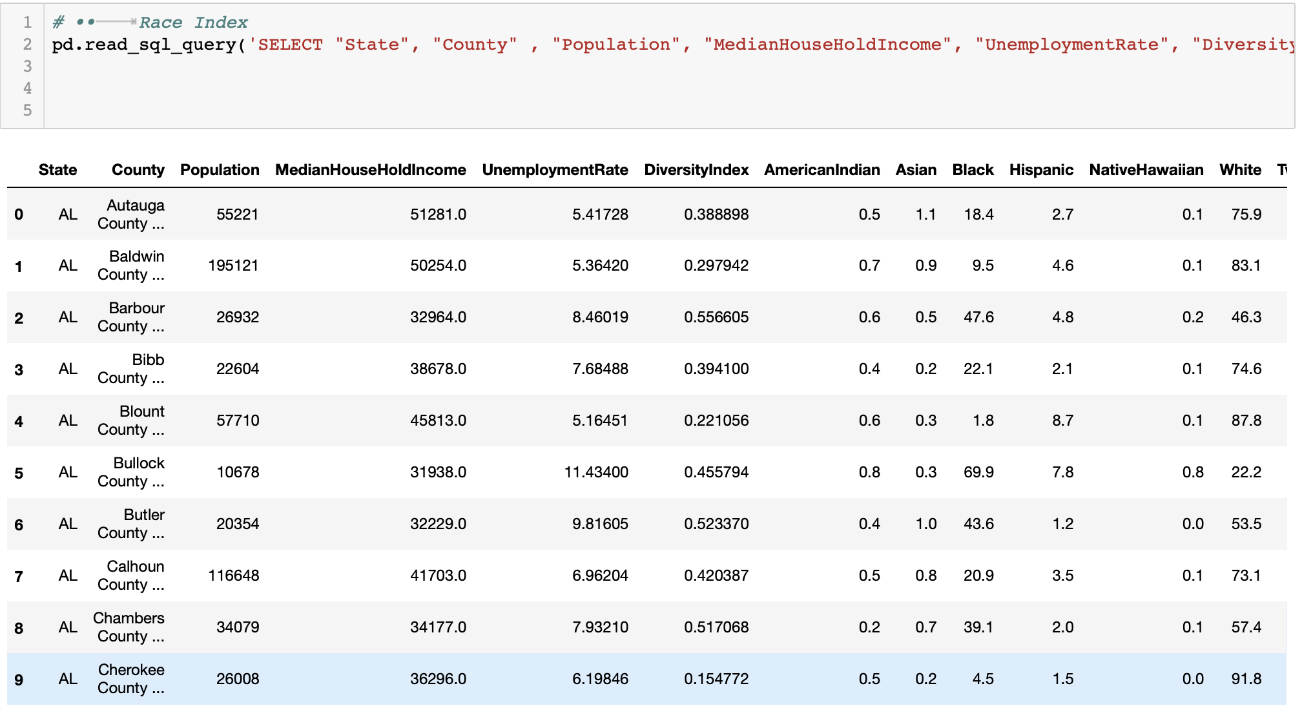
IV. Answers to My research questions

Slide 16

Pragathi madushinIe
ETL PROJECT → Relationship between Diversity, Household income and Unemployment

Slide 17


